Slide 1
Socio - Distantiator
A smart wearable device to maintain social distancing among people.

Slide 2
Problem Addressed
The device tackles one of the biggest issues of 2020, where we are unable to get back to our normal lives without worrying about COVID 19.
This has impacted millions of lives, almost every sector is suffering from it.
The device is capable of bringing the cases count to a halt while we move back to our normal lives.
It ensures that the wearer is maintaining proper social distancing from everyone around him.
The device will be impactful in location such as schools/colleges/coaching institutes/offices where user may accidently not follow social distancing.
It will also be useful in any kind of public gatherings.
2
Notes:
2

Slide 3
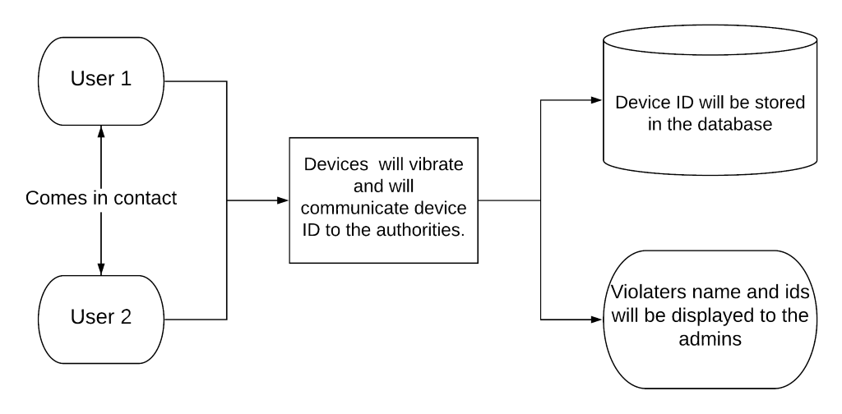
Innovation & Action
To ensure people follow social distancing we propose a wearable device called Socio Distantiator.
This device is capable of ensuring that the user is maintaining a suggested distance from another person.
If the person violates Social Distancing term he will be warned and the admins will be communicated about the violation (in case of close surrounding like a college, school, office). Admins can monitor violations through a web interface.
3
Notes:
3

Slide 4
Competitive Advantage
SWAT(Strength Weakness advantage and Threats) Analysis
STRENGTHS
This device will help in ensuring safety of an individual everywhere they go.
This device will not have any privacy concerns as only the violation and the device id will be communicated to the concerned authority. It does not record location or any other personal data.
WEAKNESS
It may not correctly detect and inform about all the devices it encountered all together. This can be improved by developing better hardware.
ADVANTAGES
This device can be used in future for helping blind people.
It can also be useful in any kind of public gatherings.
This device can help in order to stop the increasing number of COVID cases.
THREATS
In future, when the COVID-19 pandemic ends, the device may become obsolete. We are working on integrating more health awareness features in the product for usage at that point of time.
4
Notes:
4

Slide 5
Business Model
Key Activities: We will provide two kind of services: 1. Physical devices to the organizations. 2. Personalized web interface with personalised features to the organization. The physical device can be brought through a one time payment and the services will be charged on recurring basis.
Key Resources: We require hardware (microcontroller and sensors) and cloud infrastructure for the product.
Key Targets: The device targets schools/colleges/offices admins, who want to resume the usual working of the organization. By providing such device to members of their organization they will ensure the safety of the members.
Value Propositions: The device ensures safety inside an organization, allowing them to resume their work from offices and slowly and steadily get back to normal. This will highly helpful in case of school/colleges where the education is highly impacted by the pandemic. The organization will now be able to charge complete fees to the students instead of discounted one as in the case of online classes.
5

Slide 6
Way Forward
We have successfully developed the prototype of the product and are now working to ensure that the product remains relevant even after pandemic by introducing more health awareness features in the device.
6

